Slide 1
insertion sort
The idea behind the insertion sort is that first, it takes one element and iterates it through the sorted array. Although it is simple to use, it is not appropriate for large data sets, as the time complexity of insertion sort in the average case and worst case is O(n2), where n is the number of items. Insertion sort is less efficient than other sorting algorithms like heap sort, quick sort, and merge sort etc. Insertion sort is a stable sorting algorithm.

Slide 2
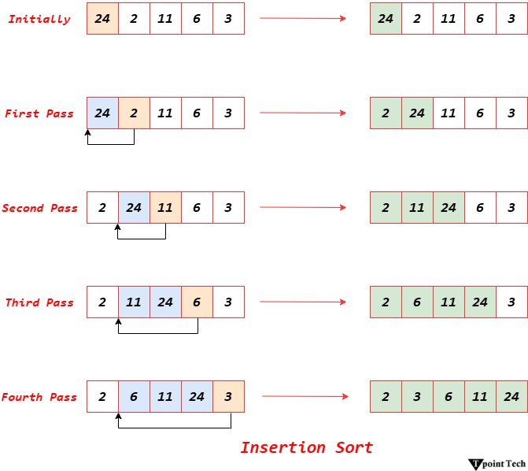
Working of the Insertion Sort Algorithm

